Slide 1
Defining functions
Function conventions
Functions

Slide 2
Python
Functions
Keyword: def
Functions allow you to reuse code by defining a block that performs a specific task.
Functions accept input values (arguments), process them, and return an output, simplifying complex operations and reducing repetition in your code.
#Step 1: define function
def function_name(arguments):
#code block – do something
return output_variable
#Step 2: use function by calling it and inputting your arguments
function_name(arguments)
Functions are first class objects in python, which means they can be assigned to variables, stored in data structures, passed as an argument or returned from a function.
Five arguments types to consider when creating and using functions:
Positional arguments are passed in the order they appear in the function.
Keyword arguments are passed with their names, order-independent.
Optional arguments have default values set, which mean the inputs can be omitted in the function call.
*args accepts multiple positional arguments, packed as a tuple.
**kwargs accepts multiple keyword arguments, packed as a dictionary.

Slide 3
Practicing functions:
Basics
Create a function that uses each of the argument types, and combinations.
Assign the function output to a variable.
Use a function as an input into another function
Incorporating logic
Write a recursive function (such as factorial, Fibonacci sequences, or tree Traversal).
Write a function that uses list comprehension (such as, returning only the even numbers in a list).
Extra for experts
Write a class that contains several functions (such as, a calculator class with methods for addition, subtraction, multiplication, and division).
Implement function overloading, using *args or conditional logic (such as, a function that sums values for 2 numbers a list).
Create a decorator function, that can wrap around any function (such as, a function that returns the log and time taken for the function to execute).
Functions
Best Practice
Annotation throughout, explaining the usage for each function.
Single functionality, adding functionality through decorator functions (such as logging, timing, or access control).
Temporary Variables, to avoid overwriting existing data.

Slide 4
Functions: Five types of Arguments
Argument Type | Description | Example Function Definition | Example Usage
Positional | Arguments passed in order, assigned to parameters by their position. | def greet(name, age): print(f"Hello {name}, {age}!") | greet("John", 30)
Keyword | Arguments passed with explicit parameter names, allowing flexibility in the order of arguments. | def greet(name, age): print(f"Hello {name}, {age}!") | greet(name="John", age=30)
Optional | Arguments with default values that can be omitted. If omitted, the default value is used. | def greet(name, age=30): print(f"Hello {name}, {age}!") | greet("John") #uses default age of 30
Variable-Length Positional (*args) | Allows a function to accept any number of positional arguments, stored in a tuple. | def greet(*names): for name in names: print(name) | greet("John", "Jane", "Alice")
Variable-Length Keyword (**kwargs) | Allows a function to accept any number of keyword arguments, stored in a dictionary. | def greet(**details): for k, v in details.items(): print(f"{k}: {v}") | greet(name="John", age=30)

Slide 5
[]
Pandas Library

Slide 6
Python
Pandas
Python Package
Pandas is designed for data manipulation and analysis, great at handling missing data, reshaping and aggregating data, and time series processing.
Introduces two primary data types: Series (1D labelled array) and DataFrame (2D table-like).
#step 1: import Pandas package
Import pandas as pd
The Pandas package in Python provides functionalities for querying and manipulating structured data, as well as data analysis and transformation.
Key Pandas functionalities are SQL-like and Excel-like:
Data Alignment and Handling of Missing Data: automatically aligns data based on labels and can efficiently handle missing data, making data cleaning easier.
Powerful Data Manipulation: Provides robust functionality for reshaping, merging, and aggregating data, making complex data manipulation tasks straightforward.
Time Series Processing: Offers rich support for time series data, allowing for easy date and time manipulation and analysis.
Integration with Other Python Libraries: Seamlessly integrates with libraries like NumPy for numerical operations and Matplotlib and Seaborn for data visualization.
Read and Write Data: Capable of reading from and writing to various file formats (CSV, Excel, SQL databases, etc.), facilitating easy data import and export.

Slide 7
1. Data Creation, Importing, and Exporting
Operation | Command | Description | Python Example
Creating a DataFrame | pd.DataFrame() | Create a new DataFrame from dictionaries, lists, or arrays. | df = pd.DataFrame({'A': [1, 2], 'B': [3, 4]})
Reading Data | pd.read_csv() pd.read_excel() | Load data from CSV, Excel, or other formats (JSON, SQL, etc.) into a DataFrame. | df = pd.read_csv('data.csv’) df = pd.read_excel('data.xlsx')
Exporting Data | df.to_csv() df.to_excel() | Save the DataFrame to a CSV or Excel file. You can also export to other formats (JSON, SQL, etc.). | df.to_csv('output.csv', index=False) df.to_excel('output.xlsx')
DataFrame
Creating the DataFrame
2. Data Inspection and Descriptives
Operation | Command | Description | Python Example
Viewing Data | df.head() df.tail() | Display the first or last 5 rows of the DataFrame by default. Else, specify the number as the argument. | df.head(3) df.tail(2)
Basic Info | df.info() df.shape() list(df.columns) | Display a concise summary of the DataFrame, including index, column types, and memory usage. | df.info() df.shape() list(df.columns)
Statistics | df.describe() | Generate summary statistics (count, mean, std, min, max, quartiles) for numerical columns. | df.describe()
Package: Pandas

Slide 8
3. Data Selection & Filtering Operations that involve selecting specific data from the DataFrame by rows, columns, or conditions.
Operation | Command | Description | Python Example
Selecting Columns | df['col_name'] / df[['col1', 'col2']] | Select a single or multiple columns from the DataFrame. | df['A'] / df[['A', 'B']]
Selecting Rows by Index | df.loc[] / df.iloc[] | Select rows by index label (loc) or integer position (iloc). | df.loc[0] / df.iloc[1]
Filtering Data | df[df['col'] > value] | Filter rows based on a condition applied to a column. | df[df['A'] > 1]
DataFrame
Creating the DataFrame
4. Data Manipulation Operations that modify or update the DataFrame by adding, removing, or altering data
Operation | Command | Description | Python Example
Adding a Column | df['new_col'] = ... | Add or assign values to a new or existing column. | df['C'] = df['A'] + df['B']
Dropping Rows/Columns | df.drop() | Remove rows or columns by label or index. | df.drop('A', axis=1) / df.drop(0, axis=0)
Renaming Columns | df.rename(columns={'old': 'new'}) | Rename columns by passing a dictionary where old names are keys and new names are values. | df.rename(columns={'A': 'Alpha'})
Sorting Data | df.sort_values(by='col_name') | Sort the DataFrame by values in one or more columns. You can specify ascending (ascending=True/False). | df.sort_values(by='A', ascending=False)
Package: Pandas

Slide 9
5. Combining DataFrames Operations for merging or concatenating multiple DataFrames.
Operation | Command | Description | Python Example
Selecting Columns | df['col_name'] / df[['col1', 'col2']] | Select a single or multiple columns from the DataFrame. | df['A'] / df[['A', 'B']]
Selecting Rows by Index | df.loc[] / df.iloc[] | Select rows by index label (loc) or integer position (iloc). | df.loc[0] / df.iloc[1]
DataFrame
Creating the DataFrame
6. Data Cleaning, Reshaping, and Aggregation Operations to change the layout or group data for analysis.
Operation | Command | Description | Python Example
Handling Missing Data | df.isna() / df.fillna() / df.dropna() | Detect missing values with isna(), fill them with a specified value using fillna(), or drop rows/columns with missing data using dropna(). | df.fillna(0) / df.dropna() / df.isna()
Grouping Data | df.groupby('col').agg() | Group data by a column and apply aggregation functions like sum(), mean(), etc. You can also use multiple aggregations with agg(). | df.groupby('A').sum()
Pivot Table | df.pivot_table() | Create a pivot table for summary statistics. Specify index, columns, and aggfunc (e.g., sum). | df.pivot_table(values='B', index='A', columns='C', aggfunc='sum')
Reshaping Data | df.melt() / df.pivot() | Reshape data from wide to long format with melt() and long to wide format with pivot(). | df.melt(id_vars='A', value_vars=['B', 'C'])
Package: Pandas

Slide 10
Python
DataFrame
Exploring the DataFrame
#Exploring a DataFrame
df.shape
#(42640, 6) output gives rows vs columns
list(df.columns)
#[‘tpnb’, ‘total_sales’, ‘total_volume’] output lists the names of variables
df.head()
#output gives the top 5 rows; while df.tail() would give the bottom 5 rows.
df.describe()
#output gives a statical summary of variables in DataFrame
Package: Pandas

Slide 11
Python
DataFrame
Selecting from the DataFrame
#Select columns by name
df[‘tpbn’]
#output a single column series
df[[‘tpbn’, ‘total_sales’]]
#output is a DataFrame with two columns
#Select rows by number
df.iloc[2]
#iloc = index location
#output all values in row 3 (index start at [0]) for each variable
df.loc[2]
#loc = location
#output all values in row 2 for each variable
Package: Pandas

Slide 12
Practicing functions:
Basics
Create a function that uses each of the argument types, and combinations.
Assign the function output to a variable.
Use a function as an input into another function
Incorporating logic
Write a recursive function (such as factorial, Fibonacci sequences, or tree Traversal).
Write a function that uses list comprehension (such as, returning only the even numbers in a list).
Extra for experts
Write a class that contains several functions (such as, a calculator class with methods for addition, subtraction, multiplication, and division).
Implement function overloading, using *args or conditional logic (such as, a function that sums values for 2 numbers a list).
Create a decorator function, that can wrap around any function (such as, a function that returns the log and time taken for the function to execute).
Functions
Best Practice
Annotation throughout, explaining the usage for each function.
Single functionality, adding functionality through decorator functions (such as logging, timing, or access control).
Temporary Variables, to avoid overwriting existing data.

Slide 13
Pandas: DataFrame commands

Slide 14
Useful Modules
Function conventions
Python Cheat Sheets

Slide 15
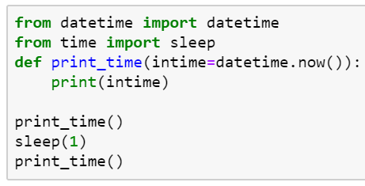
Python Modules: useful collections to get started
Modules are collections of pre-written code (functions, classes, variables) that you can import and use in your programs.
Module |  | Datetime
Code |  | Sleep
About |  | Sleep is a function stored in the datetime module, for getting your script to pause for a given number of seconds
Caution |  | [something about the default setting? Slide 30]
Example

Slide 16
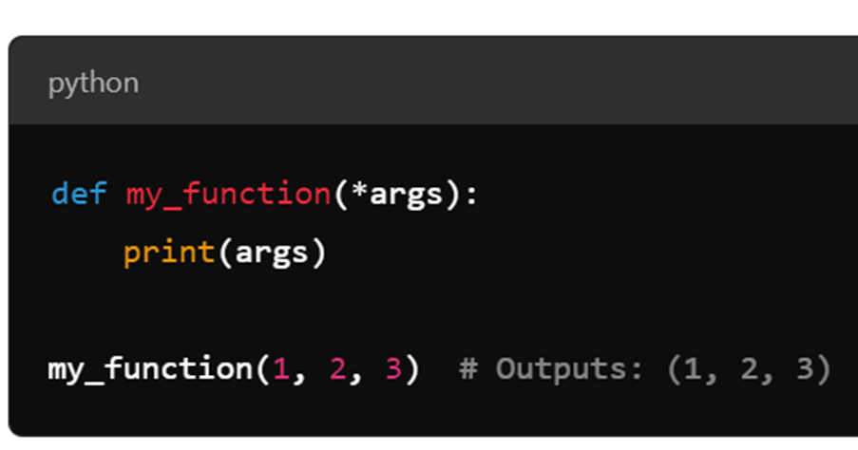
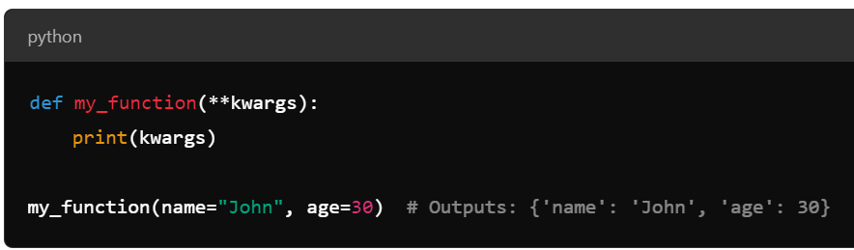
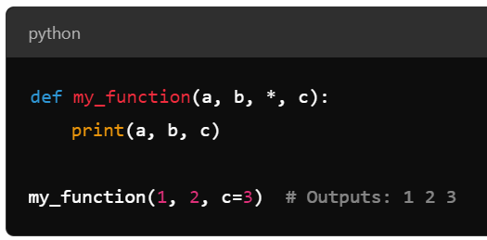
Python conventions: Positional and Keyword Arguments in functions
Convention choice will depend on the function argument needs.
Convention |  | *args | **kwargs | * (on Its Own)
Purpose |  | Passes a variable number of positional arguments | Passes a variable number of keyword arguments | Forces all arguments after * to be keyword-only arguments
Data Type |  | Packed into a tuple (immutable) | Packed into a dictionary (mutable) | N/A (just enforces keyword arguments for parameters after it; requires Python 3)
Accessing Data |  | Access arguments by position (index) | Access arguments by name (key) | Access arguments by name after *
Function Definition |  | def my_function(*args): | def my_function(**kwargs): | def my_function(a, b, *, c):
Use Case |  | When you want to accept an unknown number of positional arguments | When you want to accept an unknown number of keyword arguments | When you want to enforce that certain parameters must be passed by name
Example

Slide 17
Glossary
Glossary | Example
Pickle File | Pd.read_pickle() | A pickle file is a binary file format used to serialize and store Python objects. "Pickling" is the process of converting a Python object (such as a list, dictionary, or even a machine learning model) into a byte stream, which can then be saved to a file or sent over a network. "Unpickling" is the reverse process, where the byte stream is converted back into the original Python object. Key Points: Serialization: Pickling converts Python objects into a format that can be saved or transferred. Deserialization: Unpickling reads the pickle file and reconstructs the original object. Use Cases: Pickle files are commonly used for saving machine learning models, caching data, or storing complex objects for later use.

Slide 18
[]
Additional Slides

Slide 19
Function Convention: *args
Glossary:
Positional argument: are passed to a function and are based on its position or order in the function call, rather than being explicitly named.
Tuple: an ordered collection of items that cannot be modified after they are created (immutable). Tuples allow mixed data types, and elements of a tuple can be accessed using their index, starting at 0.
Handles an unknown number of positional arguments in a flexible manner, unpacking them into a tuple for further processing inside the function.
Flexible Argument Passing: You can pass any number of arguments, from zero to many, and Python will collect them into a tuple.
Positional Arguments: *args only collects positional arguments. If you need to accept named keyword arguments (e.g., name=value), you will use **kwargs instead.
Order Matters: In the function definition, *args must come after any fixed positional arguments.

Slide 20
Function Convention: **kwargs
Glossary:
Keyword argument: are arguments passed as key-value pairs – key: value; name = “john”.
Dictionary: a collection of key-value pairs, where each key is mapped to a specific value. Dictionaries are unordered and can be changes within the function (mutable).
items(): Returns a list of all key-value pairs as tuples
Handles an unknown number of keyword arguments and unpack them into a dictionary, providing flexibility in passing and processing data in functions.
Flexible Argument Passing: **kwargs lets you pass any number of keyword arguments without needing to specify them in advance. This makes the function flexible and adaptable to different situations.
Unpacking: Python "unpacks" the keyword arguments into key-value pairs and places them in the dictionary kwargs.

